Slide 1
GUI Programming
Ramaswamy Krishnan Chittur

Slide 2
Graphical User Interface (GUI) programming
Various UI frameworks:
MFC, WPF, WinUI 3, Swift UI etc.
We will be focusing on WPF and XAML:
WPF: a UI framework for creating desktop client applications.
XAML: a declarative language that's based on XML, used extensively to build UX.
References:
WPF: What is WPF? - Visual Studio (Windows) | Microsoft Docs
XAML: XAML overview - Visual Studio (Windows) | Microsoft Docs

Slide 3
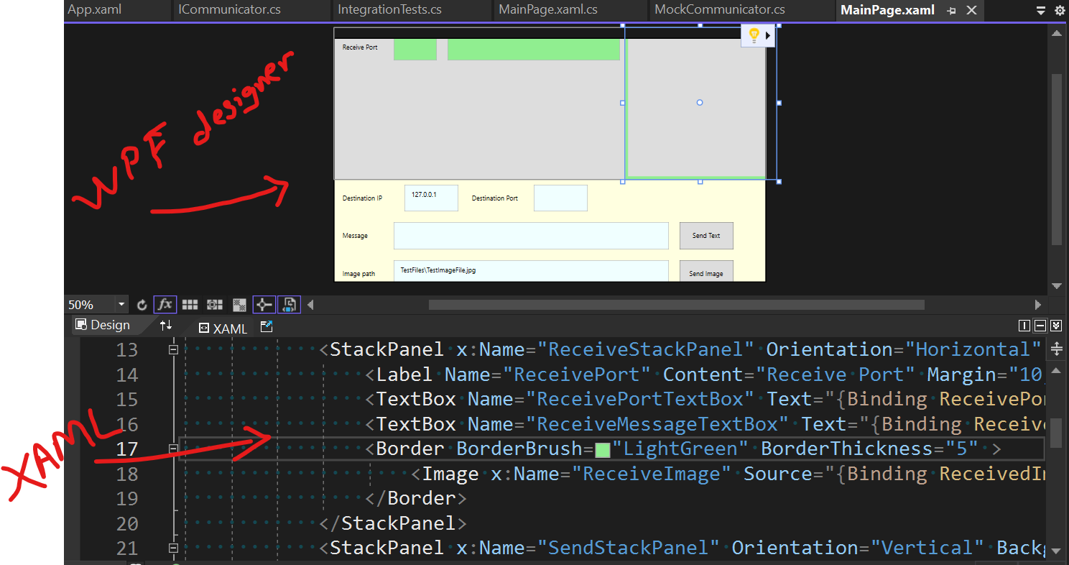
WPF and XAML

Slide 4
GUI Programming Design Patterns
Various UX design patterns:
Model-View-Controller (MVC)
Model-View-Presenter (MVP)
Model-View-ViewModel (MVVM)
References:
MVC: Overview of ASP.NET Core MVC | Microsoft Docs
MVP: Design Patterns: Model View Presenter | Microsoft Docs
MVVM: The Model-View-ViewModel Pattern - Xamarin | Microsoft Docs

Slide 5
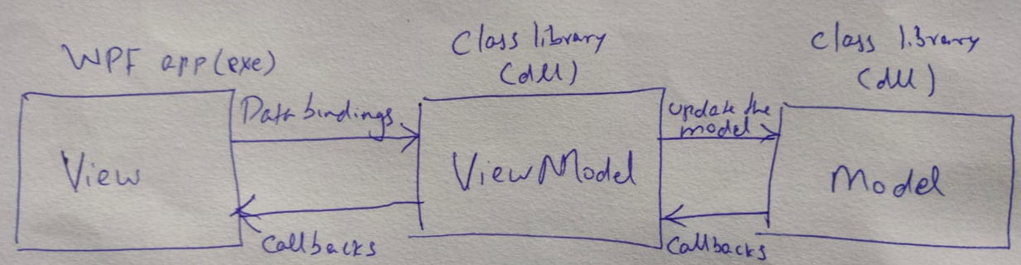
Model-View-ViewModel (MVVM)
MVVM:
Model: Business logic.ViewModel is the layer that acts as a bridge between the View and the Model. It may or may not transform the raw data from the Model into a presentable form for the View. An example transformation would be: a boolean flag from the model to string of 'True' or 'False' for the view.
View: The GUI that the user sees.
ViewModel: Connects the view to the business logic.
Data Bindings: Two-way communication between the View and the ViewModel.
MVVM - Writing a Testable Presentation Layer with MVVM | Microsoft Docs

Slide 6
Model-View-ViewModel
Advantages:
Business logic separated from the UI layout. Connected via the ViewModel adapter.
The ViewModel and the Model can be unit tested independent of the View.
The View can be remodelled independently.
Design and development can go in parallel, and mostly independent of each other. Designers can focus on the view, while developers can work on the view model and model components.
Disadvantages:
Overkill for smaller applications.
Complex data bindings can be hard to debug.

Slide 7
GUI programming fundamentals
Core principles:
Keep UI thread responsive. Delegate to worker threads to unblock the UI thread.
Access UI elements only on the UI thread (on most UI frameworks, including WPF).
References:
Keep the UI thread responsive - UWP applications | Microsoft Docs
Calling Synchronous Methods Asynchronously | Microsoft Docs

Slide 8
Code Samples
chittur/distributed-and-gui-demo: Demonstrates a distributed computing software that also involves GUI (github.com)
chittur/mvvm-custom-binding: Sample project that demonstrates how to apply custom logic to a binding using MVVM design pattern. (github.com)

Slide 9
Q & A

